Slide 1

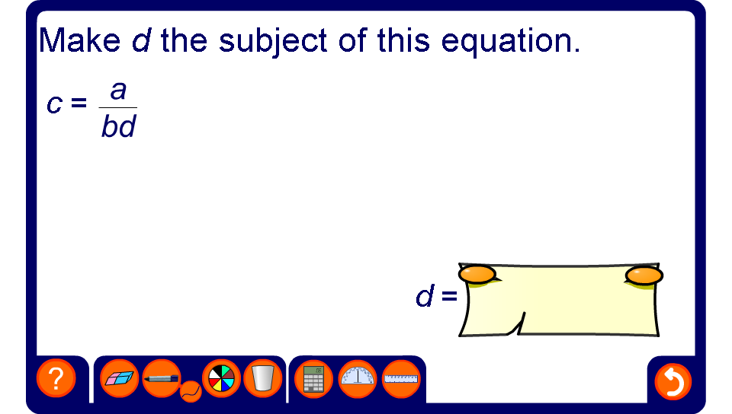


Change the subject of the formula 1
Notes:
Ask a volunteer to come to the board and use the pen tool to change the subject of the given formula.
Ask them to justify each step in their working.

Slide 2
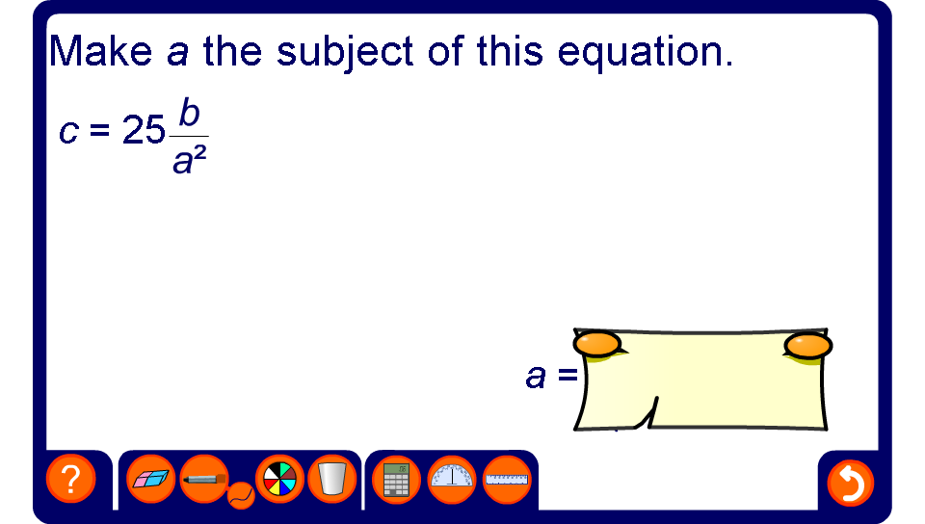
Change the subject of the formula 2
Notes:
Ask a volunteer to come to the board and use the pen tool to change the subject of the given formula.
Ask them to justify each step in their working.

